Slide 1
Hacking with ChatGPT Question answering on documents Sensemakers Amsterdam
Michiel Bontenbal
21 juni 2023

Slide 2
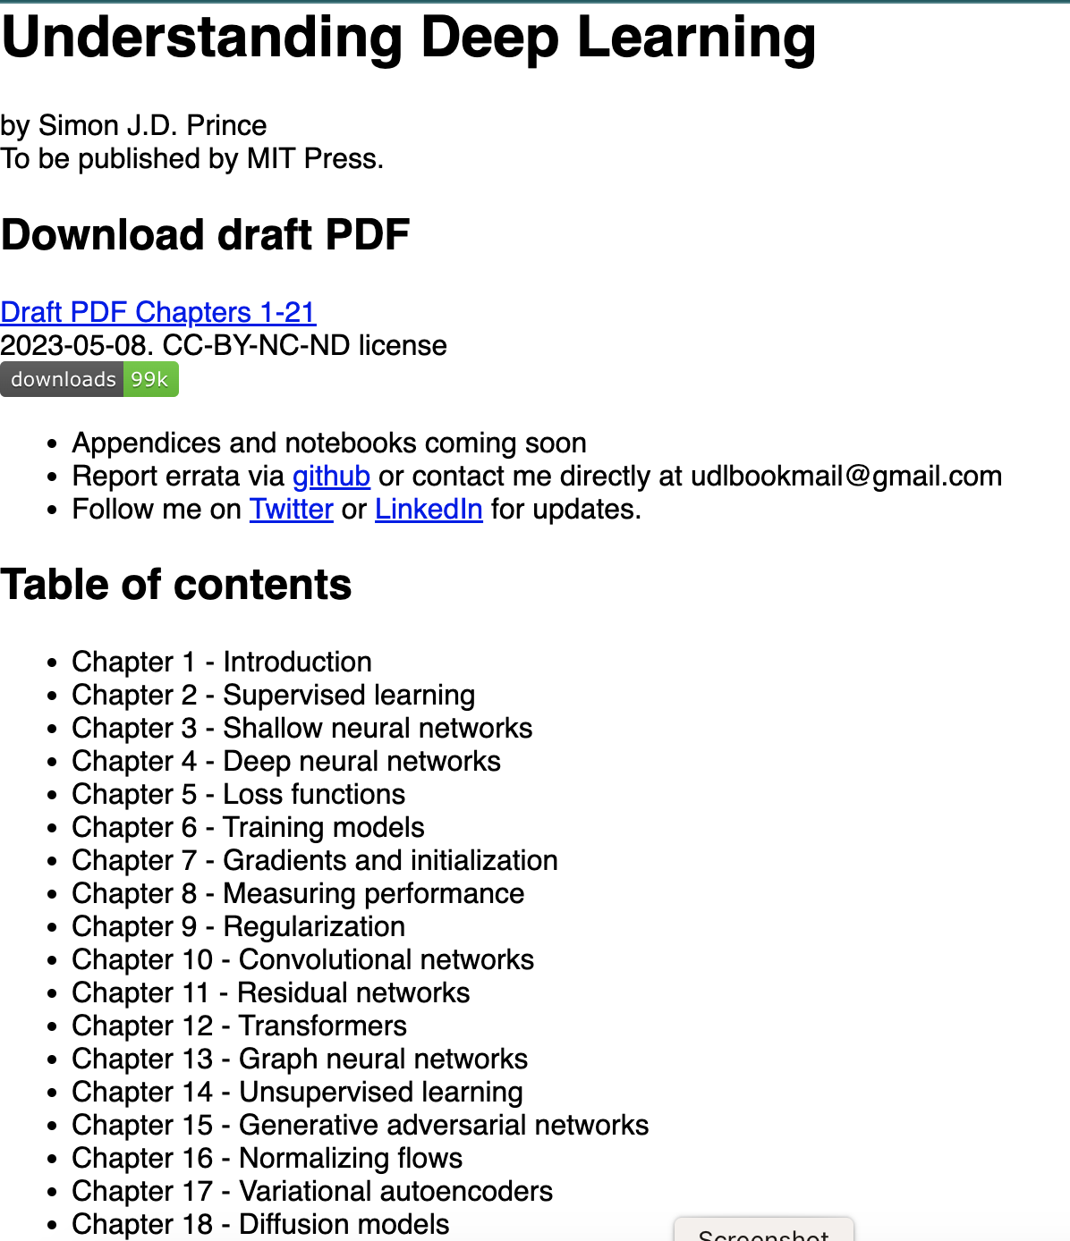
Goal – what do we want to do?
We want to answer questions on a given document.
We use OpenAI’s GPT3.5 to answer these questions.
540 pages!

Slide 3
Question and response
question = "What is a transformer?"
Response = "A transformer is a type of neural network developed for natural language processing (NLP) tasks. It is based on self-attention, which is a quadratic complexity that can process a large number of input variables. Transformers have since been used for image processing tasks, and have now eclipsed the performance of convolutional networks in this area.'"

Slide 4

Flow
1. Preparation
PDF
Convert to text and split into chunks.
Create ‘embeddings’ and store them
‘Vector library’
2. Execution
Ask question (‘prompt’)
Do similarity search
Ingest result into LLM
Response

Slide 5
LLM leidt tot nieuwe architectuur
Front-end
Logica
Data
LLM

Slide 6
Find the code on Github
https://github.com/MichielBbal/chat_with_documents

Slide 7
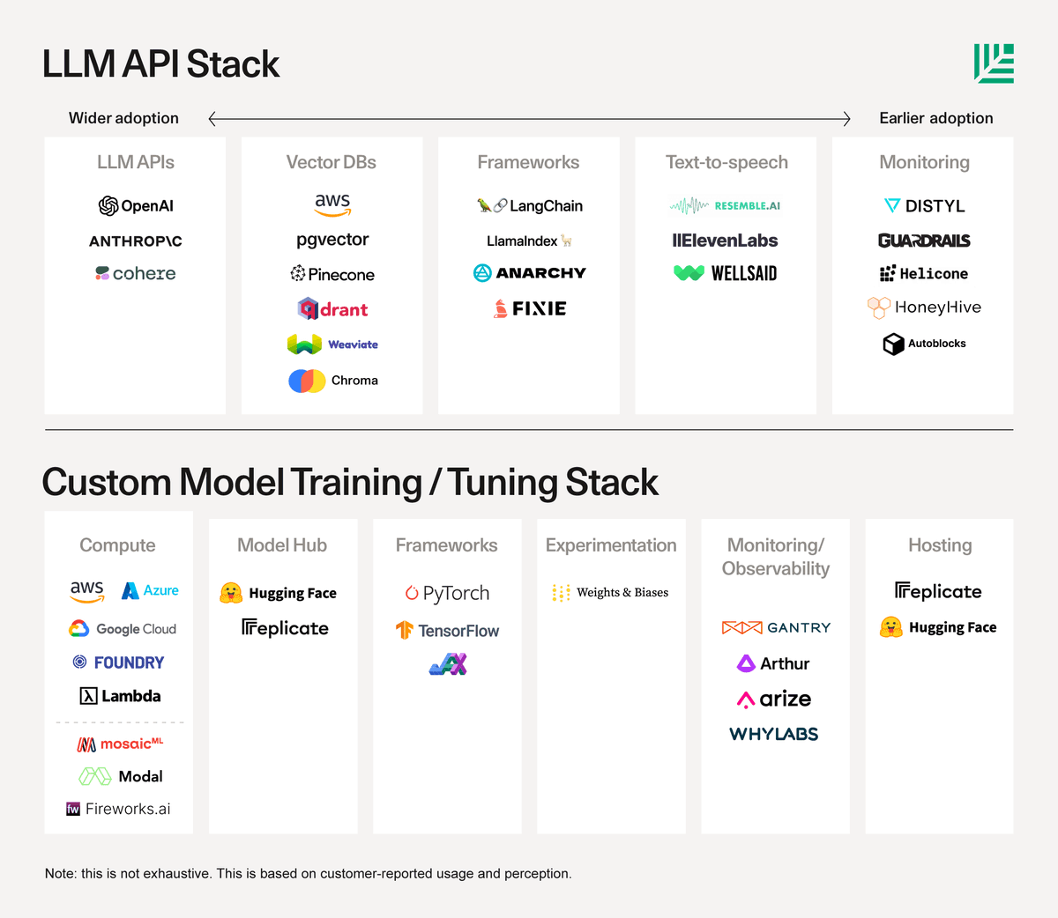
ANNEX: LLM API stack

Slide 8
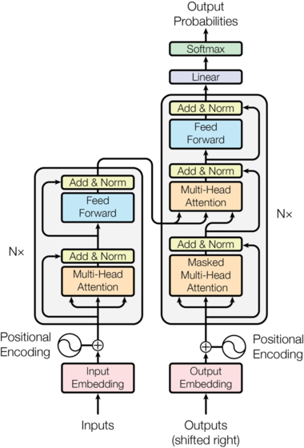
GPT: Generative Pretrained Transformer
GPT is geavanceerder dan vertalen maar in de kern lijkt het er sterk op.
Transformer:
De architectuur van het model, zie plaatje rechts, wordt ook gebruikt bij vertalen.
Pretrained:
Het model is al getrained waarbij input is gebruikt o.a.:
Internet, e-books, woordenlijsten, code etc
Generative
Het model genereert een antwoord op een input.

